Slide 1

MACHINE LEARNING TECHNIQUES FOR CYBER ATTACK DETECTION
Submitted to the faculty of Engineering of
SRI SARATHI INSTITUTE OF ENGINEERING AND TECHNOLOGY
Affiliated to JNTU-KAKINADA
2019-2023
Submitted By:
L.PAVAN KUMAR (19541A0571)
P.SAIDHANARAJ (19541A0581)
A.RUKMINI (19541A0501)
K.TEJASWI (19541A0515)
N.SRAVANI (19541A0533)
K.DURGA PRASAD (16541A0569)
Under The Guidence Of:
Mr. P.Satheesh Babu
Assistant professor, CSE.

Slide 2
CONTENTS
1. Abstract
2.Introduction
3.System Analysis
3.1.Existing System
3.2.Drawbacks Of Existing System
3.3.Proposed System
3.4.Advantages Of Proposed System
4.System Architecture
5.Modules
6.Literature Survey
7.System Requirements
7.1.Hardware Requirements
7.2.Software Requirements
8.Systen Design
9.Coding
10.Screenshots
11.Testing
12.Conclusion
13.References

Slide 3
ABSTRACT
1
The increased usage of cloud services, growing number of web applications users, changes in network infrastructure that connects devices running mobile operating systems and constantly evolving network technology cause novel challenges for cyber security. As a result, to counter arising threats, network security mechanisms, sensors and protection schemes also have to evolve, to address the needs and problems of the users. In this article, we focus on countering emerging application layer cyber-attacks since those are listed as top threats and the main challenge for network and cyber security. The major contribution of the article is the proposition of machine learning approach to model normal behaviour of application and to detect cyber-attacks. The model consists of patterns (in form of Perl Compatible Regular Expressions (PCRE) regular expressions) that are obtained using graph-based segmentation technique and dynamic programming. The model is based on information obtained from HTTP requests generated by client to a web server. We have evaluated our method on CSIC 2010 HTTP Dataset achieving satisfactory results.

Slide 4
INTRODUCTION
2
Recently the number of security incidents reported all over the world has increased. The national CERTs (e.g. CERT Poland) report that the number of attacks has increased significantly when compared to the previous years. According to the report in 2012 there were 1082 incidents, which is an increase of nearly 80% in comparison to the previous year, mainly due to malware and phishing.
There is also a significant number of reported incidents that are connected with a huge widespread adoption of the social media. This trend has an impact on accelerated spread of different kinds of malwares and viruses. As reported by SophosLabs in 2013, botnets have become more widespread, resilient and camouflaged and they are finding some dangerous new targets.
A successful injection can cause serious consequences including data loss, corruption, lack of accountability or the denial of access. Additionally, the level of prevalence is described as common, while level of detectability is identified as average. Therefore, in this article we focus on detecting emerging application layer attacks. The major contribution of this article is the proposition of a machine learning technique to model normal behaviour of application and detect cyber attacks.

Slide 5
SYSTEM ANALYSIS
3
3.1.EXISTING SYSTEM
There are two distinct categories of cyber-attack detection methods, namely signature based and anomaly based. The machine learning techniques are used in both of them. Recently machine learning-based algorithms have been used for developing signatures that will efficiently identify both the code and behaviour of the malicious code.The Network-based Signature Generation (NSG), Length-based Signature Generation (LESG) and F-Sign are the examples of algorithms designed for automated and fast extraction of signatures of polymorphic worms.The LESG algorithm targets those worms that use buffer overflow attack to infect victims, whereas the F-Sign extracts the signature on a basis of the code of a worm (such signature can be used to detect and stop the worm from spreading). In literature there are also algorithms such as SA(Semantic Aware) that are designed to generate the signatures of malicious software on a basis of the network traffic they generate. The anomaly based methods for cyber-attack detection typically build a model that describes normal and abnormal behaviour of network traffic. Commonly, such methods use three types of algorithms taken from machine learning theory, namely unsupervised, semi-supervised and supervised.

Slide 6
3.2.DRAWBACKS OF EXISTING SYSTEM
Errors and Inconsistency.
Slow, Tedious, and Time Consuming.
Lack of Security.
Information Redundency.
Needs Manual Calculations.
More Man Power.
To avoid all these limitations and make the working more accurately the system needs to be computerized in a better way.

Slide 7
3.3.PROPOSED SYSTEM
The proposed method adapts machine learning paradigm. During the learning phase the labelled data is required to establish the model parameters of the normal application behaviour.
We propose to use a graph-based approach to build a set of regular expressions that model the normal HTTP requests sent by client to the web application.
In the proposed approach, the segmentation components S are the regular expressions further explained in Section 3.3. In other words, our goal is to group the similar HTTP requests and represent them with a single pattern. In fact, the algorithm is not only limited to the HTTP protocol and can be easily adapted to other kinds of textual data, like different kinds of log files generated by the Application or databases.

Slide 8
3.4.ADVANTAGES OF PROPOSED SYSTEM
The system is very simple in design and to implement. The system requires very low system resources and the system will work in almost all configurations. It has got following features;
Minimize manual data entry.
Minimum time needed for the various processing.
Greater efficiency.
Better service.
User friendliness and interactive.
Minimum time required.

Slide 9
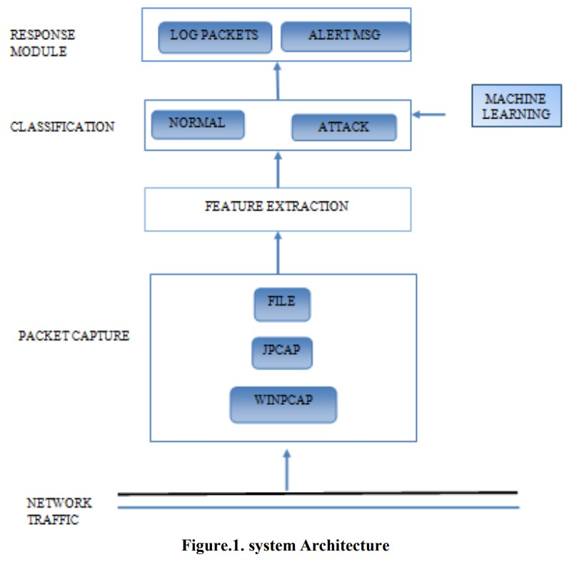
SYSTEM ARCHITECTURE
4

Slide 10
MODULES
5
DATA PREPROCESSING
MODEL BUILDING
LOGISTIC REGRESSION
RANDOM FOREST
SUPPORT VECTOR MACHINE
PREDICT ATTACK

Slide 11
LITERATURE SURVEY
6
1.TITLE : Pre-clustering algorithm for anomaly detection and clustering.
AUTHOR : M. Sharma and D. Toshniwal.
ABSTRACT : Clustering is known as grouping of data based on their similarities. This paper introduces an algorithm of k means for clustering of data streams and detection of outliers. The introduced technique for detection of outliers is based on distance as well as on time on which they arrive in the cluster. This paper also takes into account the selection of k centers and variable size of buckets with the help of which space can be effectively utilized during clustering. Most traditional algorithms make clustering a very difficult problem by reducing their quality for a better efficiency. This paper indicates that with a small increase in time you can efficiently cluster the data without much loss of quality of data.

Slide 12
2.TITLE : Correlation Approach for SQL Injection Attacks Detection.
AUTHOR : M. Chora´s, R. Kozik, D. Puchalski and W. Hołubowicz.
ABSTRACT : In this paper we prove that the correlation approach to SQL Injection Attacks allows improving results of such attacks detection. Moreover, we propose a novel method for SQLIA detection based on the genetic algorithm for determining anomalous queries. Experimental scenario is also described and the achieved results are reported.

Slide 13
SYSTEM REQUIREMENTS
7
7.1. HARDWARE REQUIREMENTS
System : Intel i3 2.2Ghz
Hard Disk : 320 GB.
Ram : 4 GB.
7.2. SOFTWARE REQUIREMENTS
Operating system : Windows 7/8/10/11.
Coding Language : Python.
Front-End : HTML, CSS, JS.
IDE : Visual Studio Code.

Slide 14
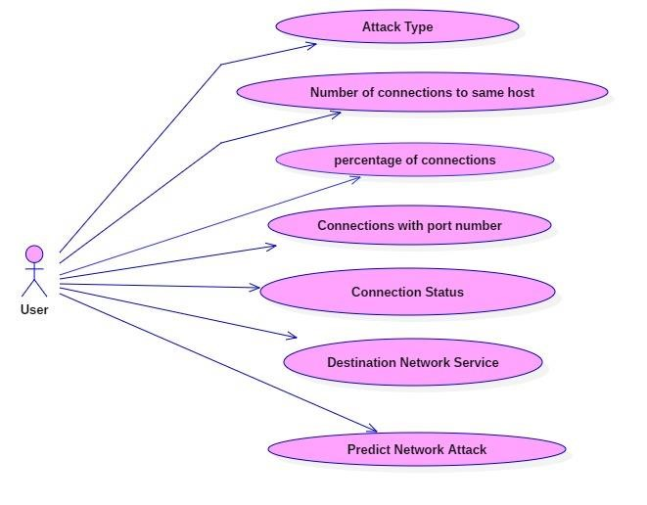
SYSTEM DESIGN
8
USECASE DIAGRAM
A use case diagram in the Unified Modeling Language (UML) is a type of behavioral diagram defined by and created from a Use-case analysis. Its purpose is to present a graphical overview of the functionality provided by a system in terms of actors, their goals (represented as use cases), and any dependencies between those use cases. The main purpose of a use case diagram is to show what system functions are performed for which actor. Roles of the actors in the system can be depicted.

Slide 15
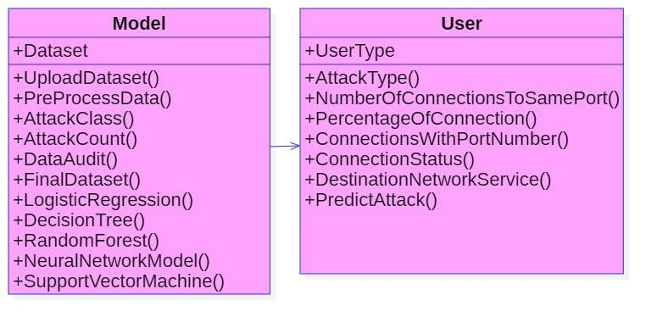
CLASS DIAGRAM
In software engineering, a class diagram in the Unified Modeling Language (UML) is a type of static structure diagram that describes the structure of a system by showing the system's classes, their attributes, operations (or methods), and the relationships among the classes. It explains which class contains information.

Slide 16
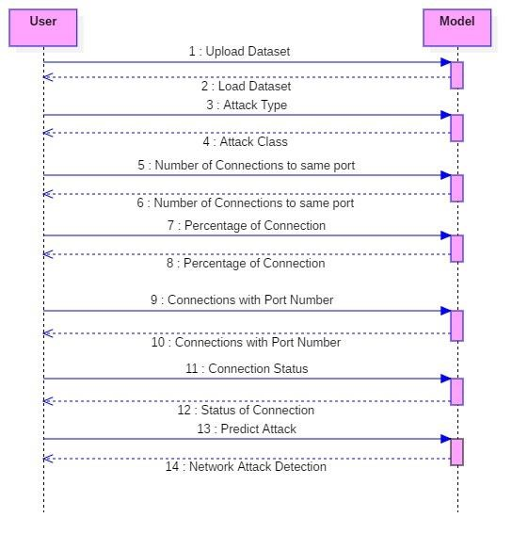
SEQUENCE DIAGRAM
A sequence diagram in Unified Modeling Language (UML) is a kind of interaction diagram that shows how processes operate with one another and in what order. It is a construct of a Message Sequence Chart. Sequence diagrams are sometimes called event diagrams, event scenarios, and timing diagrams.

Slide 17
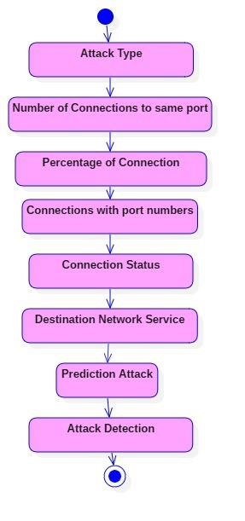
ACTIVITY DIAGRAM
Activity diagrams are graphical representations of workflows of stepwise activities and actions with support for choice, iteration and concurrency. In the Unified Modeling Language, activity diagrams can be used to describe the business and operational step-by-step workflows of components in a system. An activity diagram shows the overall flow of control.

Slide 18
CODING
9
import numpy as np
from flask import Flask, request, jsonify, render_template
import joblib
app = Flask(__name__)
model = joblib.load('model.pkl')
@app.route('/')
def home():
return render_template('index.html')
@app.route('/predict',methods=['POST'])
def predict():

Slide 19
int_features = [float(x) for x in request.form.values()]
if int_features[0]==0:
f_features=[0,0,0]+int_features[1:]
elif int_features[0]==1:
f_features=[1,0,0]+int_features[1:]
elif int_features[0]==2:
f_features=[0,1,0]+int_features[1:]
else:
f_features=[0,0,1]+int_features[1:]
if f_features[6]==0:
fn_features=f_features[:6]+[0,0]+f_features[7:]
elif f_features[6]==1:
fn_features=f_features[:6]+[1,0]+f_features[7:]
else:
fn_features=f_features[:6]+[0,1]+f_features[7:]

Slide 20
final_features = [np.array(fn_features)]
predict = model.predict(final_features)
if predict==0:
output='Normal'
elif predict==1:
output='DOS'
elif predict==2:
output='PROBE'
elif predict==3:
output='R2L'
else:
output='U2R'

Slide 21
return render_template('index.html', output=output)
@app.route('/results',methods=['POST'])
def results():
data = request.get_json(force=True)
predict = model.predict([np.array(list(data.values()))])
if predict==0:
output='Normal'
elif predict==1:
output='DOS'
elif predict==2:
output='PROBE'
elif predict==3:
output='R2L'
else:
output='U2R'
return jsonify(output)
if __name__ == "__main__":
app.run()

Slide 22
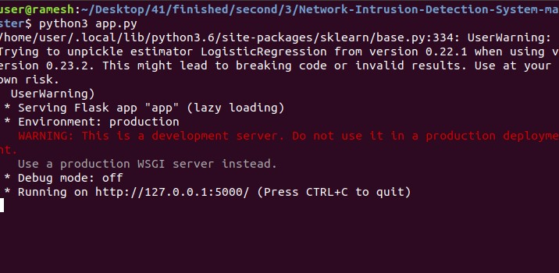
SCREENSHOTS
10
Localhost - in cmd python app.py

Slide 23
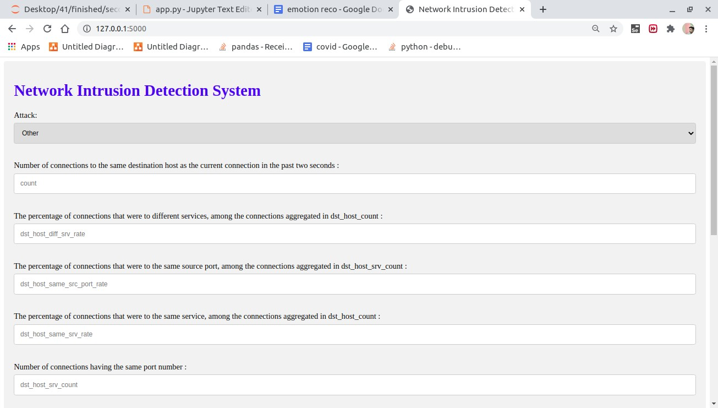

Slide 24
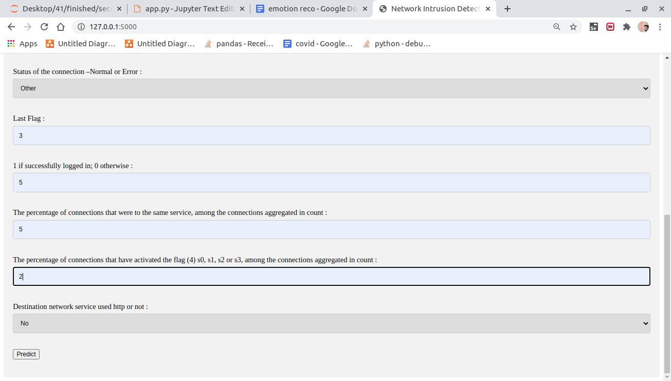
Enter the input

Slide 25
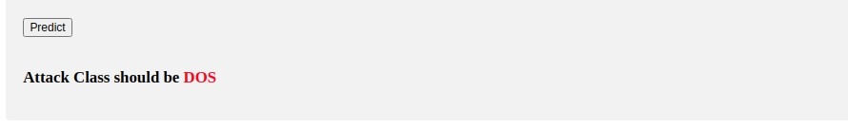
Predict attack

Slide 26
CONCLUSION
12
In this article, the method for application layer attack detection based on machine learning was proposed. The model consists of patterns that are obtained using graph-based segmentation technique and dynamic programming. The regular expressions are used for modelling the genuine behaviour of the applications and detecting cyber attacks.
We also presented the results that prove the efficiency of the proposed algorithm that can be effectively used for application layer attack detection.
The experiments show that the proposed approach can achieve 94.46% of detection ratio while having <4.5% of false positives.

Slide 27
REFERENCES
13
[1] CERT Polska Annual Report 2012. http://www.cert.pl/PDF/Report_CP_2012.pdf
[2] Cisco Annual Report 2013. http://www.cisco.com/web/about/ac49/ac20/ac19/ar2013/docs/2013_Annual_Report.pdf
[3] LESG. http://www.cs.northwestern.edu/∼ychen/Papers/LESG-ICNP07.pdf
[4] D. Kong, J. Gong, S. Zhu, P. Liu and H. Xi. SAS: semantics aware signature generation for polymorphic worm detection. International Journal of Information Security, 50, 1–19, 2011.
[5] M. Sharma and D. Toshniwal. Pre-clustering algorithm for anomaly detection and clustering that uses variable size buckets. RecentAdvances in Information Technology, 515–519, 2012.

Slide 28
THANK YOU

Slide 29
ANY QUERY?
PLEASE ASK...

